Slide 1
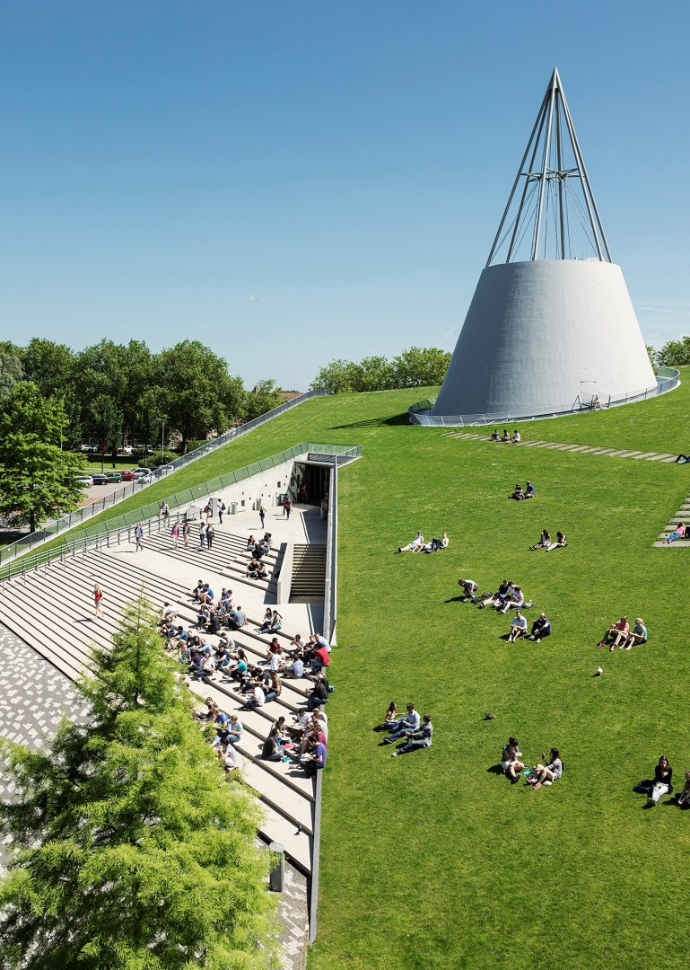
Title slide + image
LiDAR-Enhanced Closed Loop Wake Mixing Control
David Chen

Slide 2

Table of Content
Introduction
Feedback --- LiDAR
Research Question
Control Design
Current Progress
Future Work
Q & A

Slide 3
Chapter | dark mode
00
Introduction
Wake, WFFC, Helix

Slide 4
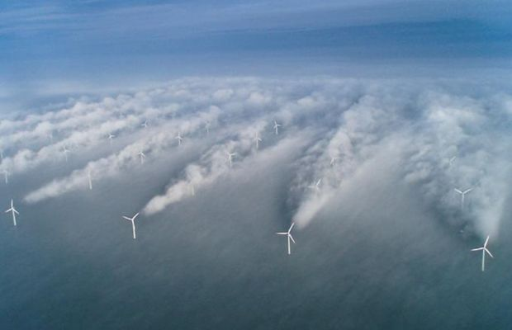
Introduction --- Wake Effect
Effect on downstream WT:
Less power production
Increase structural loads
20 – 45% Loss of Energy
Notes:
The downstream turbine encounters a significantly reduced free-stream velocity compared to the upstream turbine, leading to less energy being available in the flow.

Slide 5
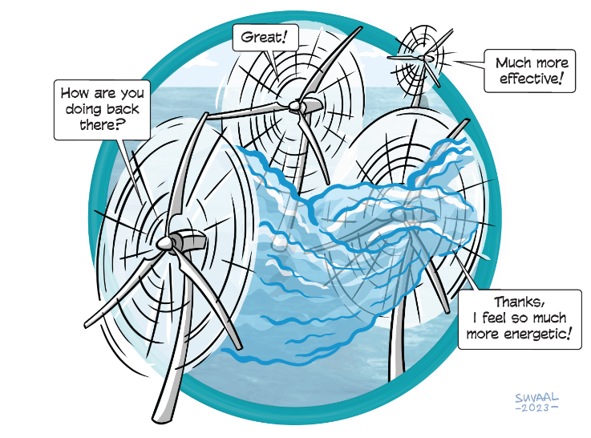
Introduction --- Wind Farm Flow Control
Axial Induction Control
Wake Steering
Wake Mixing

Slide 6
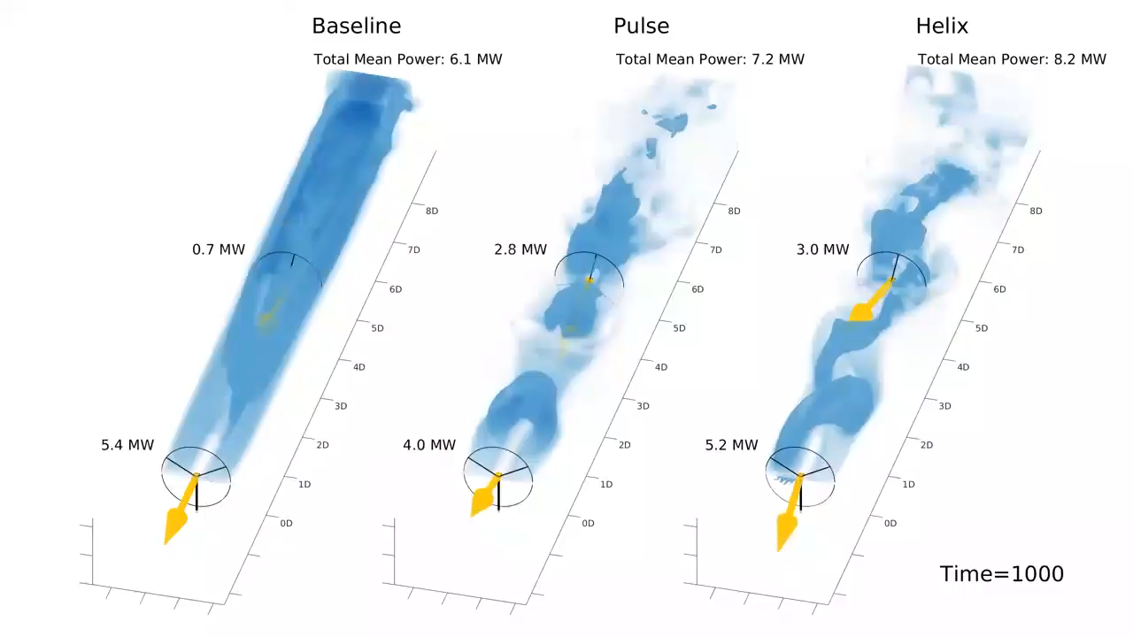
Introduction --- Wake Mixing
Facilitate mixing of free-ambient air and wake for wake recovery
Notes:
The arrow stands for the thrust force
Facilitate mixing of free-ambient air and wake for wake recovery

Slide 7
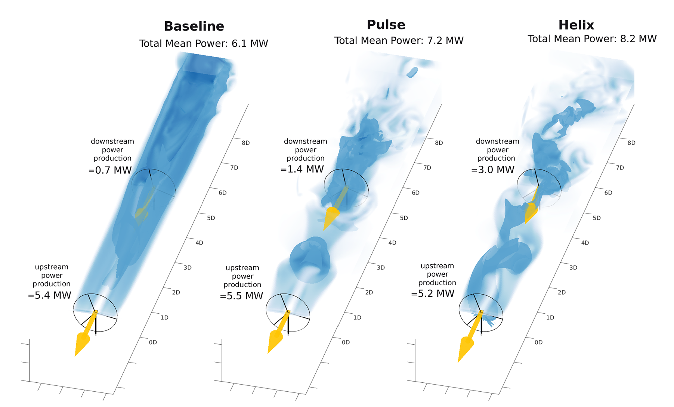
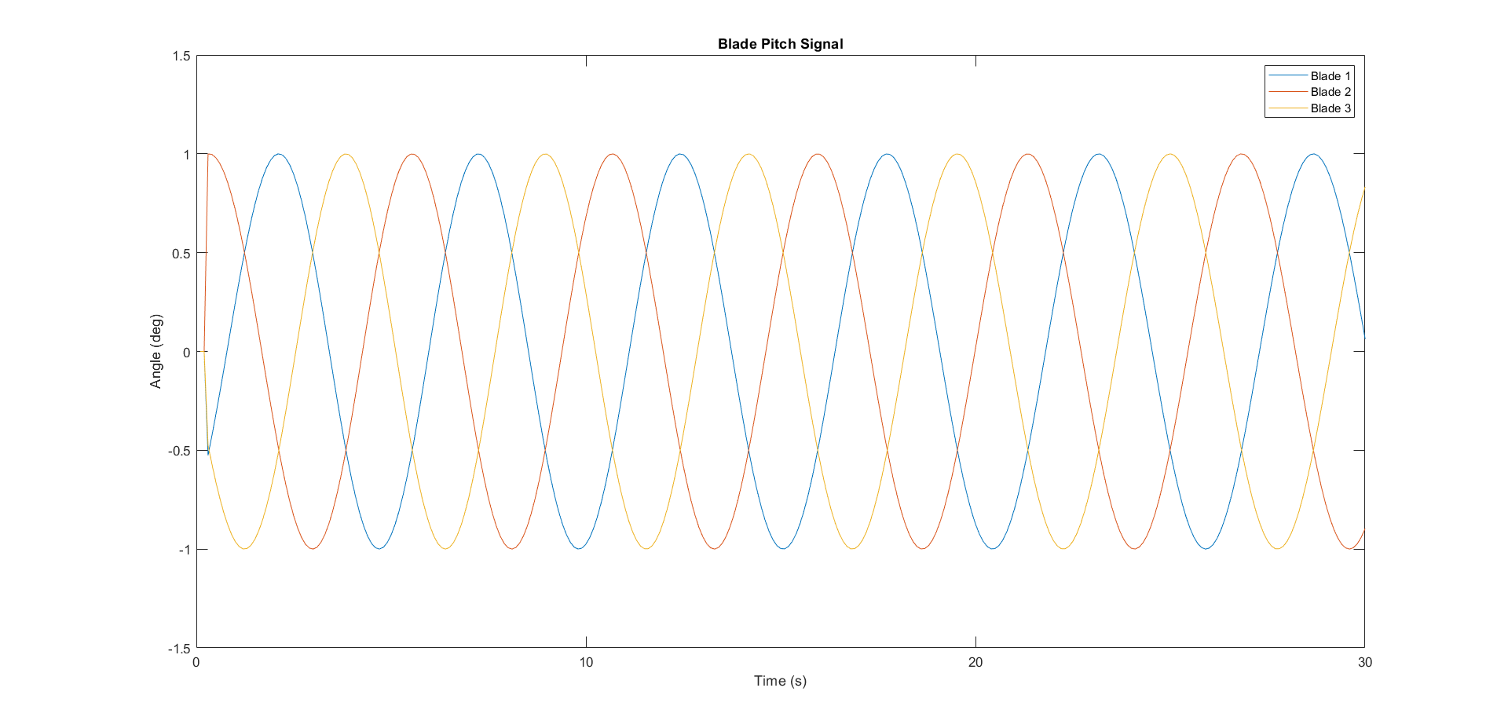
Introduction --- Helix Approach
Notes:
The wake mixing control strategy is developed to enhance the mixing of the turbine’s wake with ambient free-stream velocity air. This enhanced mixing accelerates the energy recovery of the wake more effectively than would occur through natural wake processes and recovery mechanisms.
Pulse: varying thrust coefficient sinusoidal ----> Load ----> More consistent
Helix: Individual Pitch Control

Slide 8
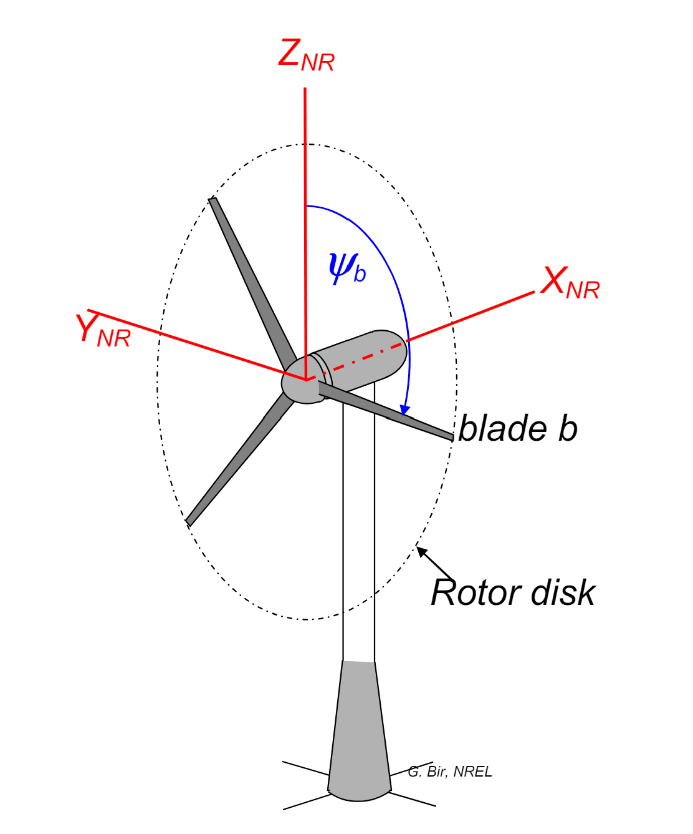
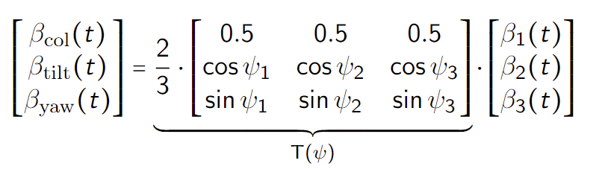
Helix Approach --- MBC Transform
Rotating Frame → Non-rotating Frame
Notes:
MBC transform map the signals from rotating frame to the non-rotating one.
In this fixed frame, the individual pitch commands can be computed as decoupled collective, tilt, and yaw pitch commands respectively, allowing simple SISO control loops instead of MIMO

Slide 9
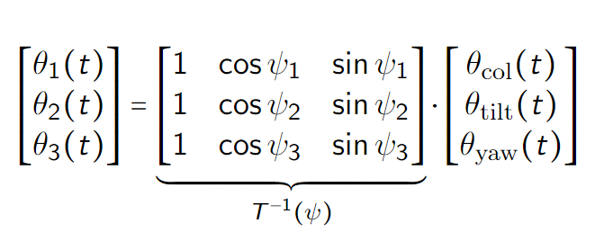
Helix Approach --- Inverse MBC Transform
Non-rotating Frame → Rotating Frame
Notes:
By using the inverse MBC, we just need to give the tilt and yaw moment, then the blade pitch signals are acquired.

Slide 10
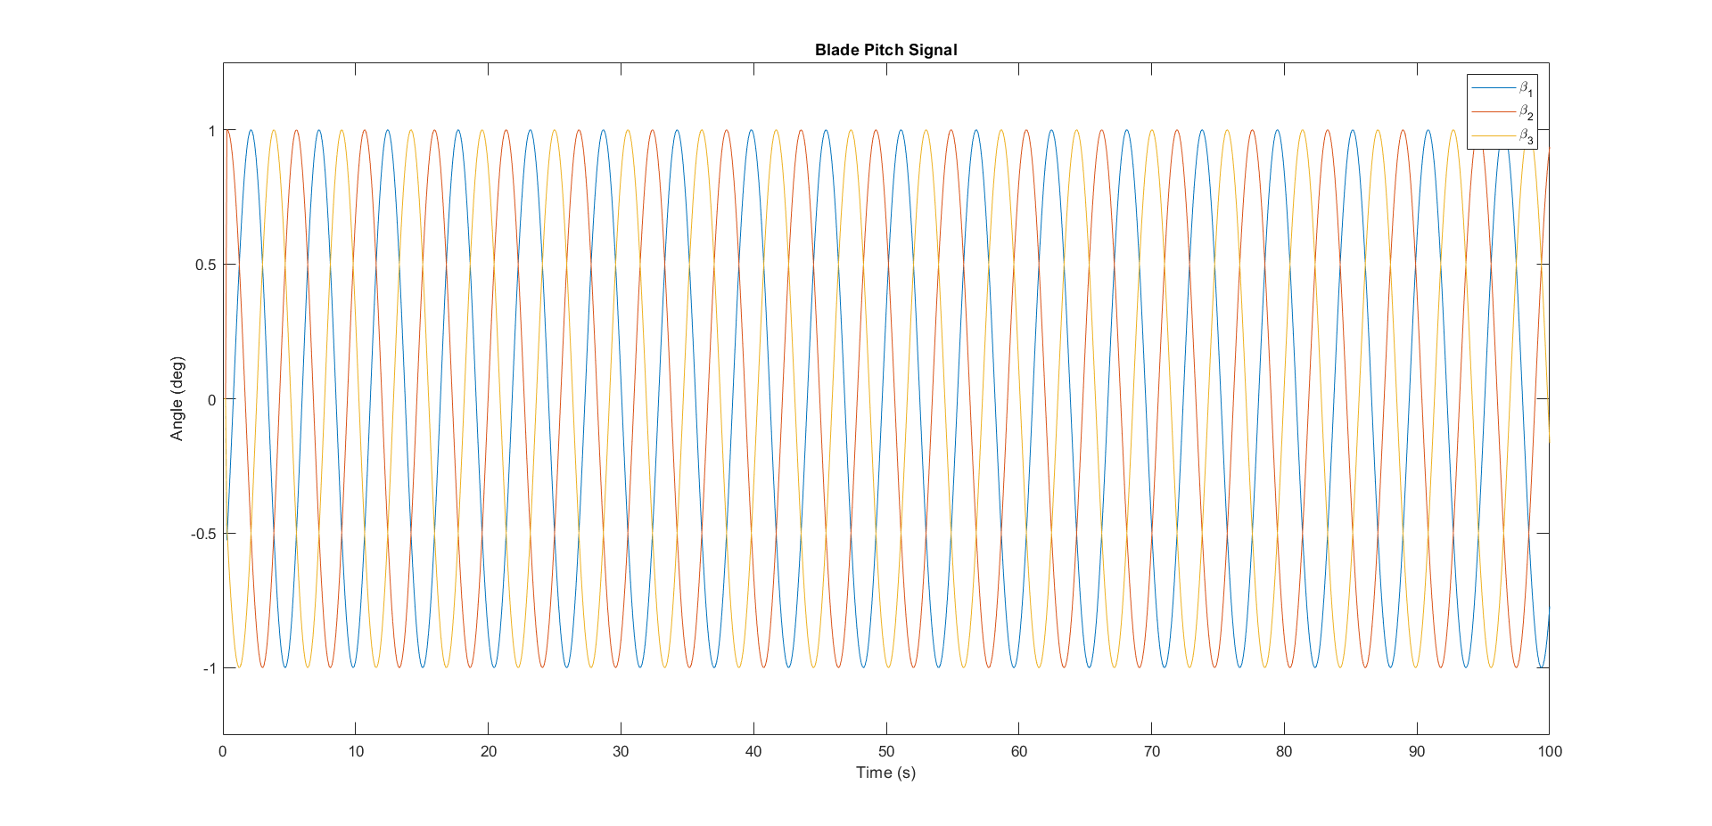
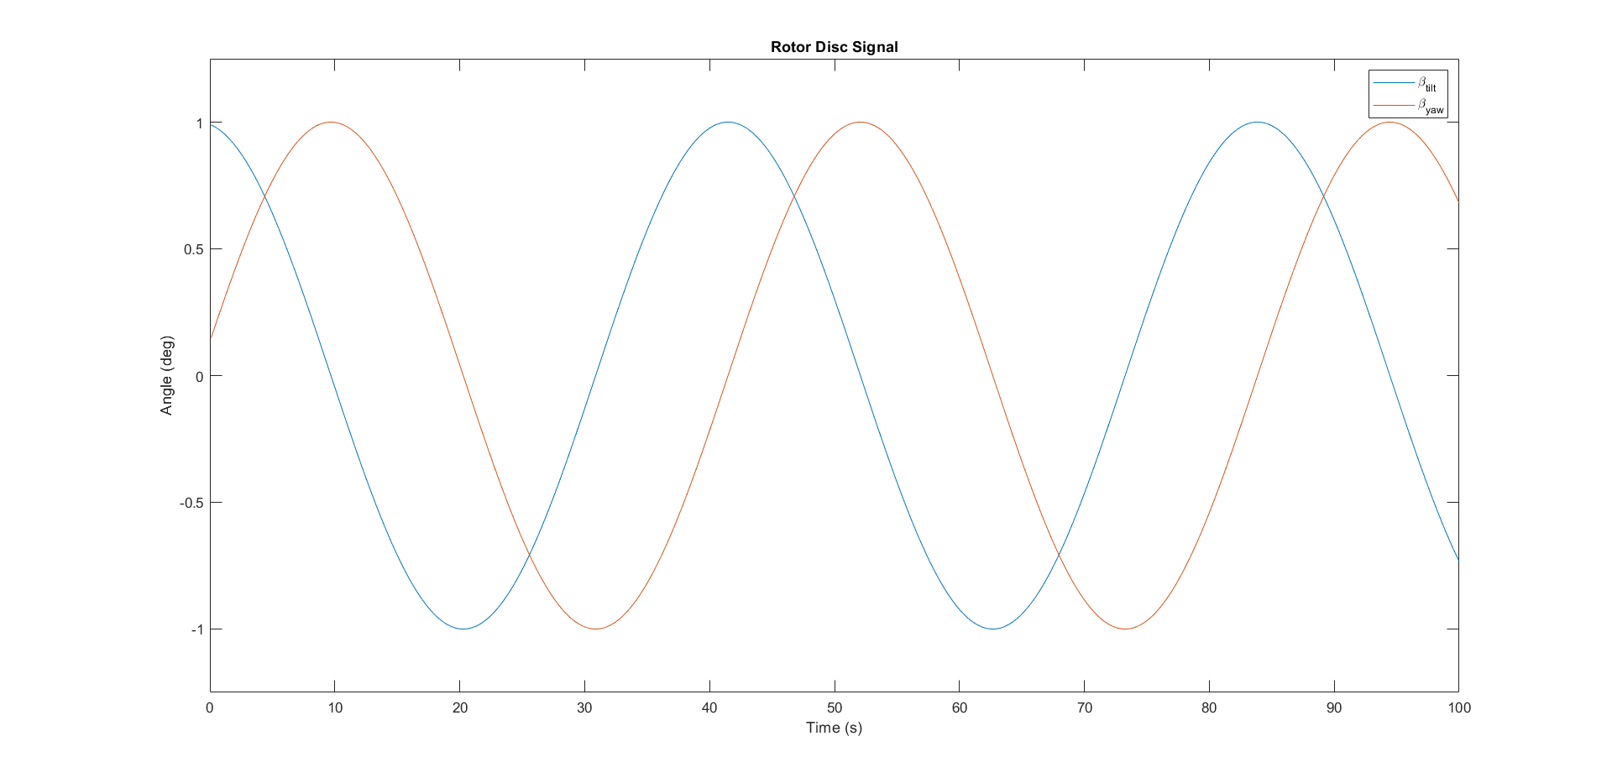
Helix Approach --- Transform
MBC
Inverse MBC
Notes:
MBC transform map the signals from rotating frame to the non-rotating one.
In this fixed frame, the individual pitch commands can be computed as decoupled collective, tilt, and yaw pitch commands respectively, allowing simple SISO control loops instead of MIMO

Slide 11
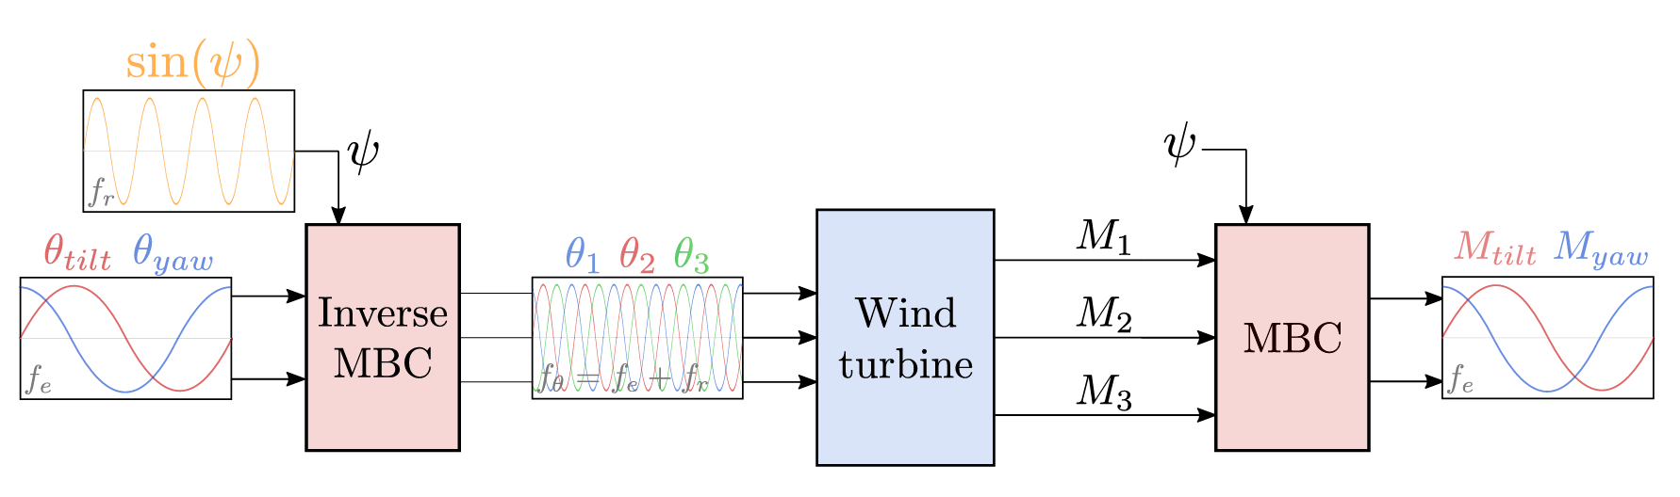
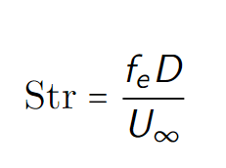
Helix --- Block Diagram
Sinusoidal signals
Frequency
Amplitude
Phase
Notes:
Beta(tilt) and Beta(yaw) for rotor disk, based on the phase different of tilt and yaw, the helix is clockwise or counterclockwise

Slide 12
Helix --- My Question
Open-Loop Control:
No feedback from output
Can we closed-loop control the helix approach based on flow information?
Notes:
Disturbance Rejection
Accuracy and Precision
Input-based control vs. Output-based control: Directly monitors and adjusts the system outputs.

Slide 13
Chapter | dark mode
01
Feedback
LiDAR

Slide 14
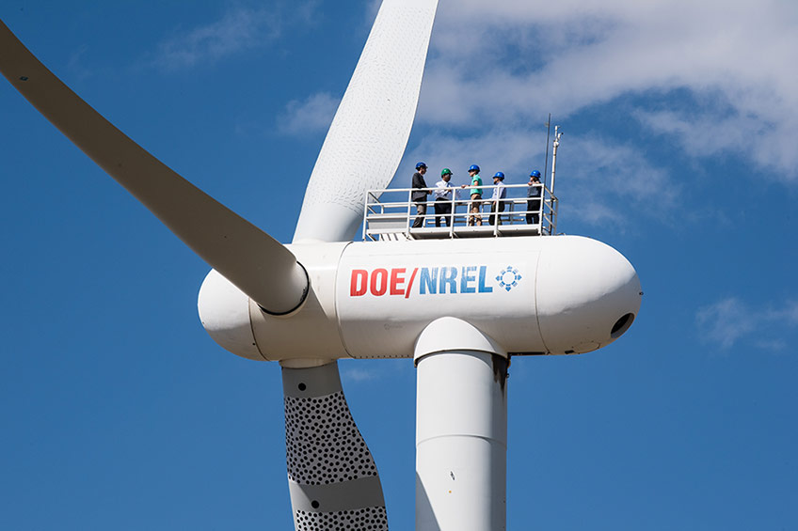
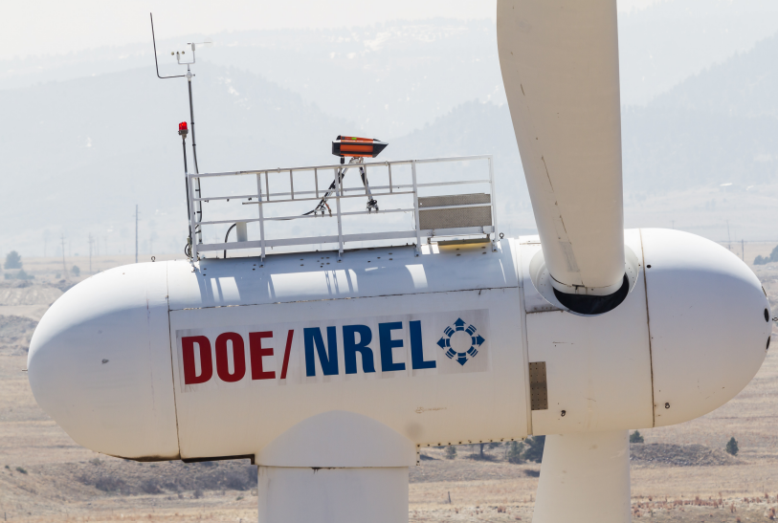
Feedback --- LiDAR
Notes:
To close the loop, one of the most important things is to get the feedback --- LiDAR

Slide 15
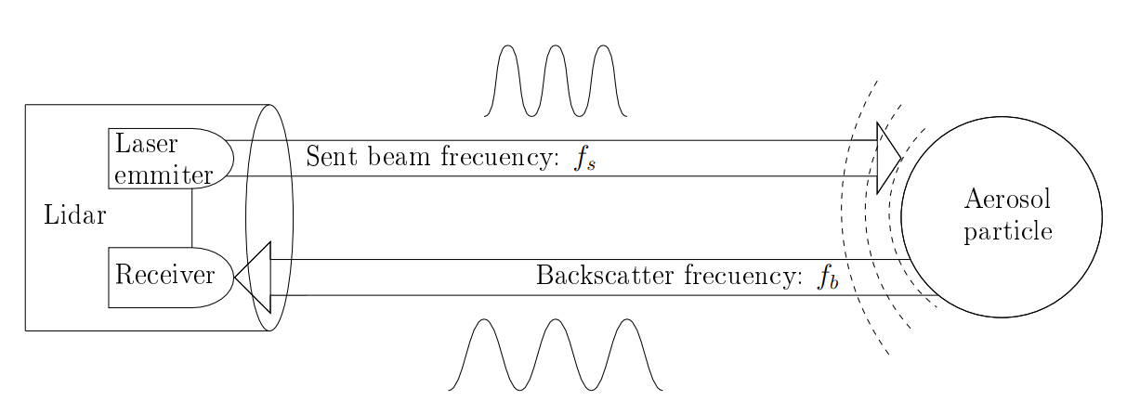
Feedback --- LiDAR Doppler Effect

Slide 16
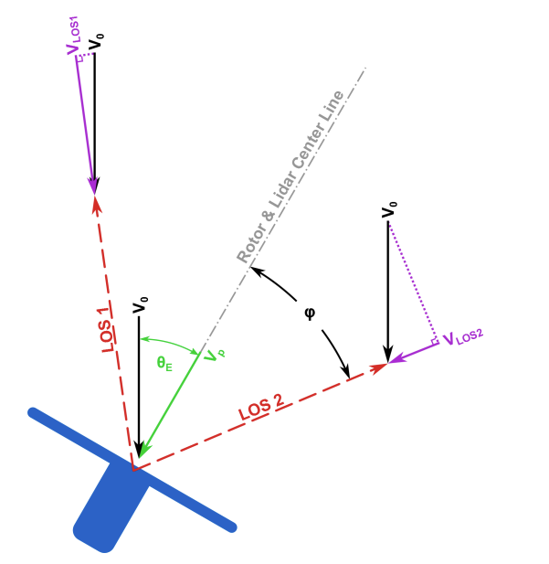
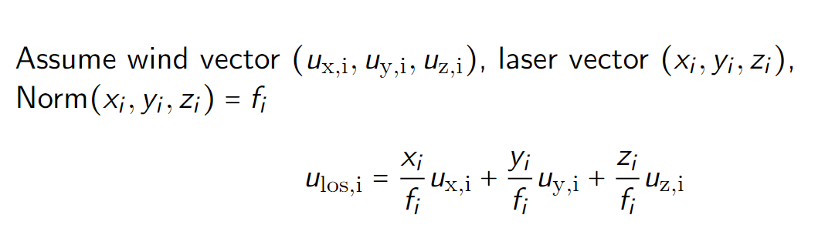
Feedback --- LiDAR
Notes:
LiDAR is placed in the perfect location --- 1.86D for IEA15MW so that the diameter of the ring is the same as D

Slide 17
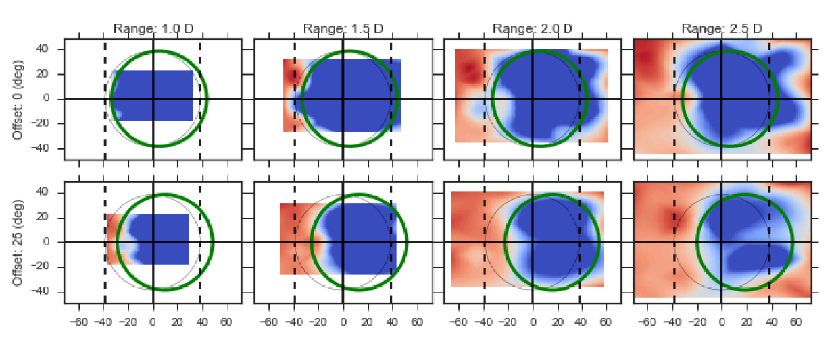
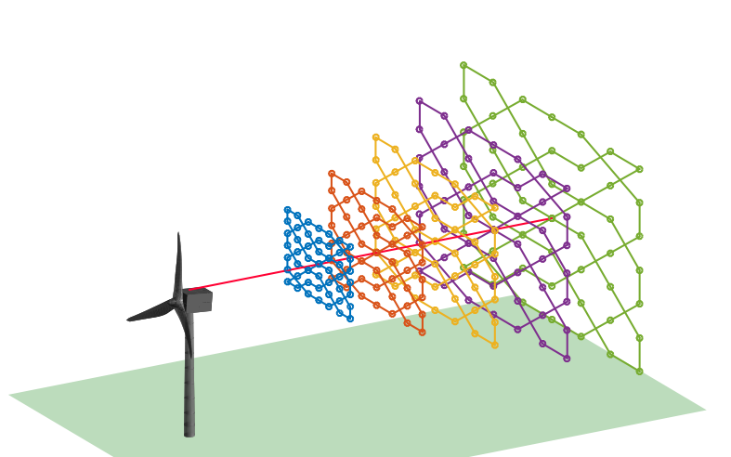
Feedback --- LiDAR Application WFFC
Notes:
Wake steering

Slide 18
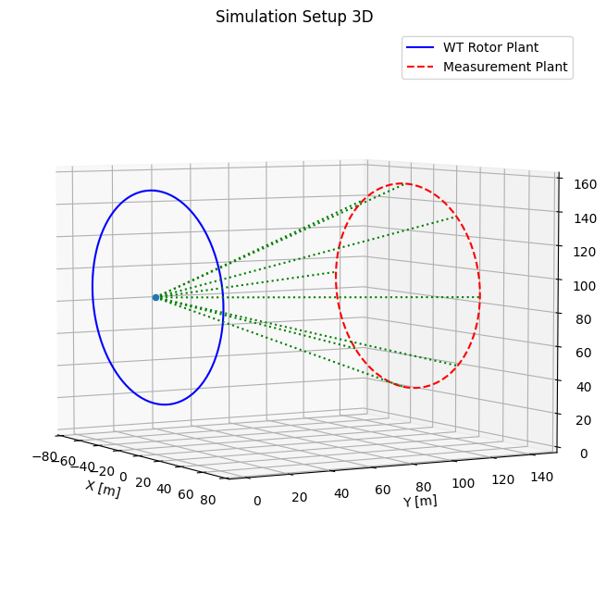
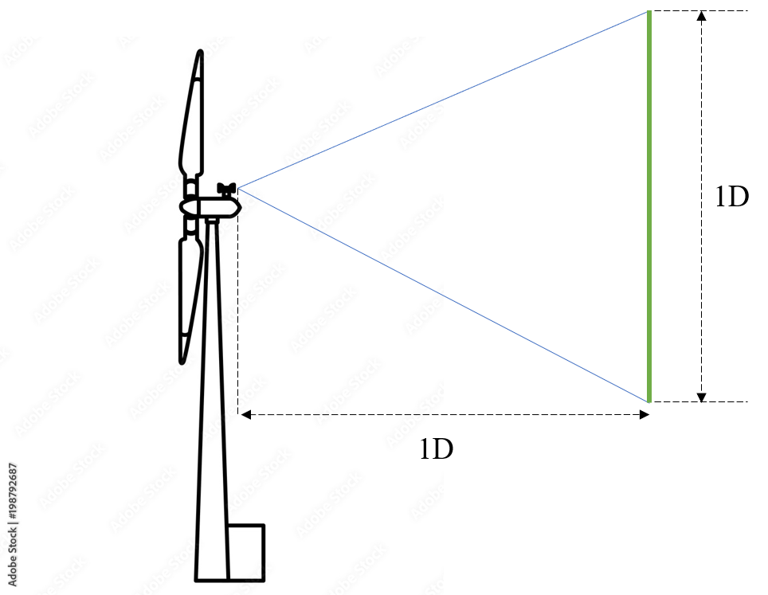
Feedback --- Simulation Setup
Continuous Wave LiDAR
Notes:
Downwind facing LIDAR
Measuring 1D (rotor disk) position

Slide 19
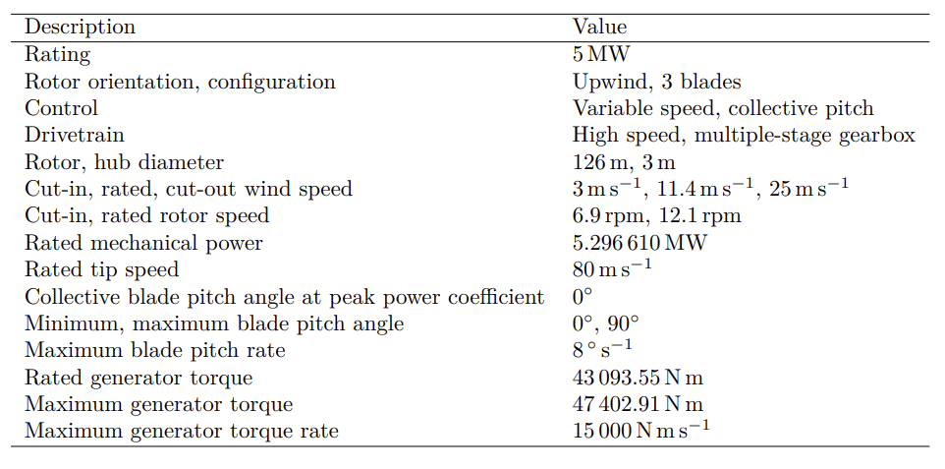


Feedback --- Practical Tool
Notes:
Q-blade
MATLAB
NREL5MW

Slide 20
Chapter | dark mode
02
Research Question
When pieces become a full puzzle

Slide 21
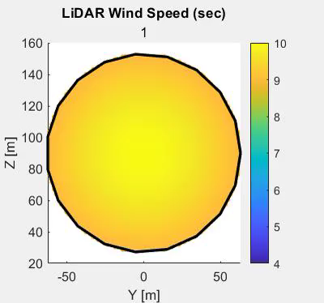
RQ --- A Look into Data
U = 10 m/s
CCW
Str = 0.3
Amplitude = 3
Notes:
Q-blade doesn’t have any LiDAR functionality, so I spent around a week time to implement the LiDAR functionality and optimize it so that it’s fast enough (2 days --> 10 mins --> 2 mins )
Wake center is what I am aiming at
1. obvious
2. accessible in real-time

Slide 22
RQ --- Questions
How to integrate LiDAR and the helix approach for closed-loop wake mixing control for wind farms?
Which LiDAR configuration to use?
What feature in the helix wake should be controlled, and how to obtain it using LiDAR?
How to design the control loop to rectify the helix?
Potential for next step?

Slide 23
Chapter | dark mode
03
Control Design
A thing I am supposed to be good at

Slide 24
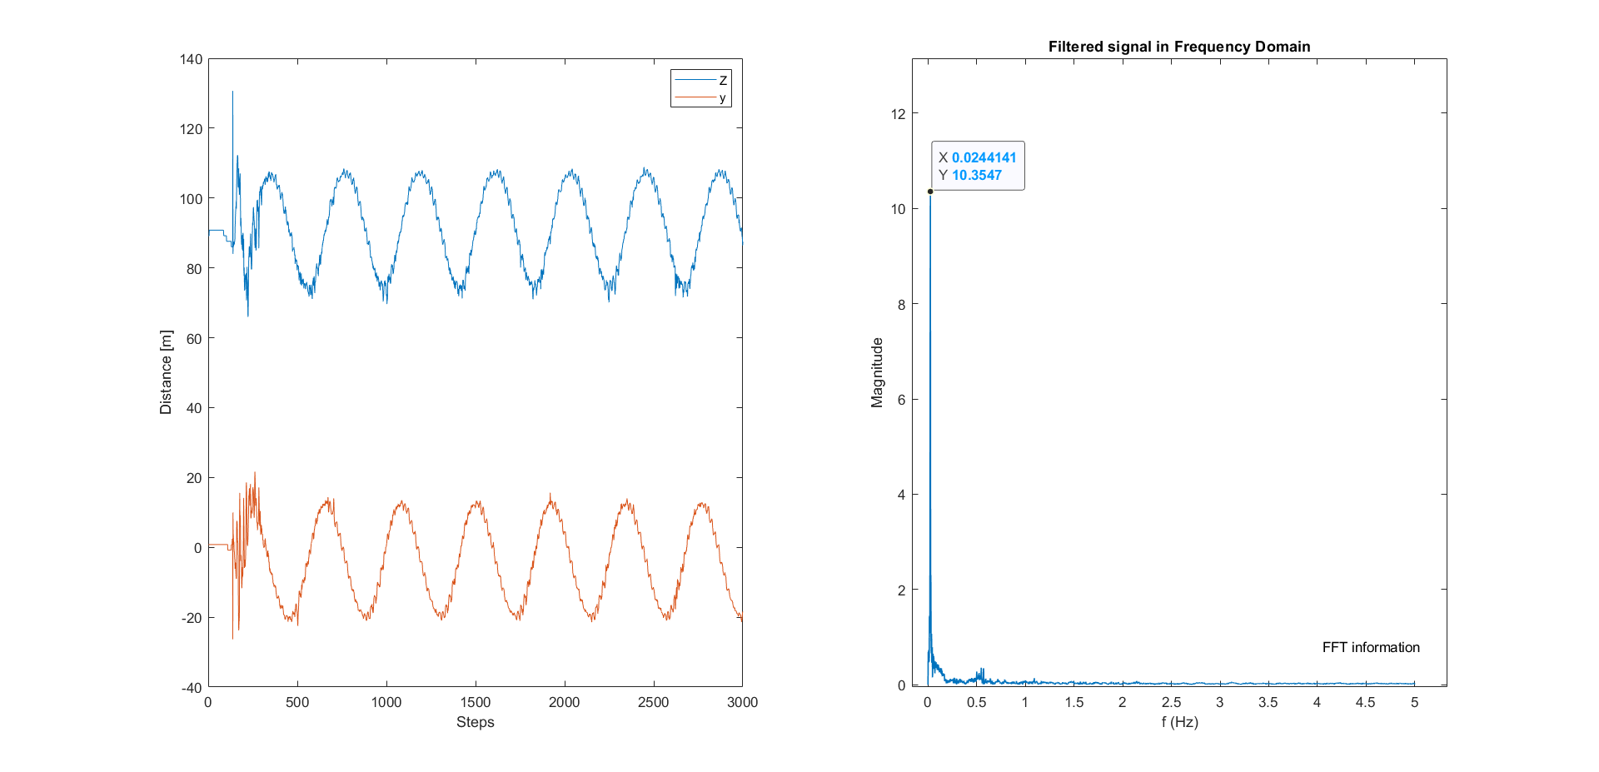
Control Design --- Helix Center
Notes:
CCW, coordinate of helix center, two periodic signal

Slide 25
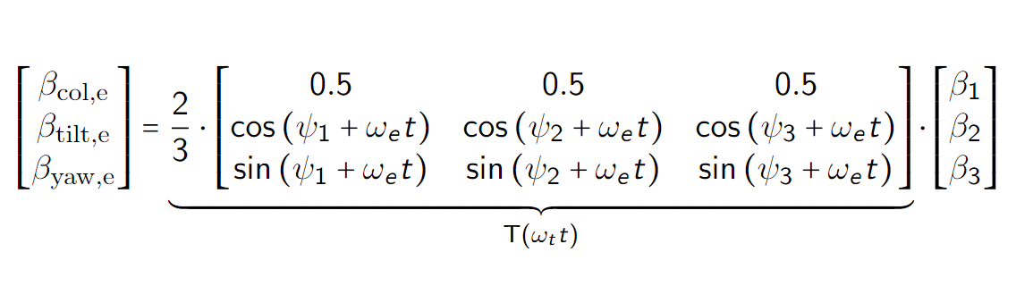
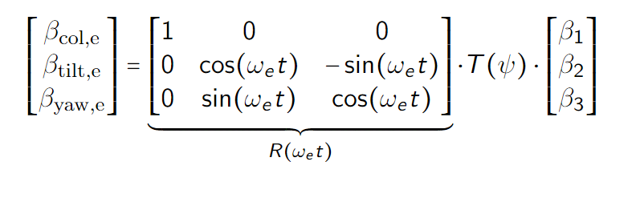
Control Design --- New Transform
Non-Rotating Frame → Helix Frame
1P, 1P+fe → 0P, fe
1P, 1P+fe → 0P, fe → 1P, 0P

Slide 26
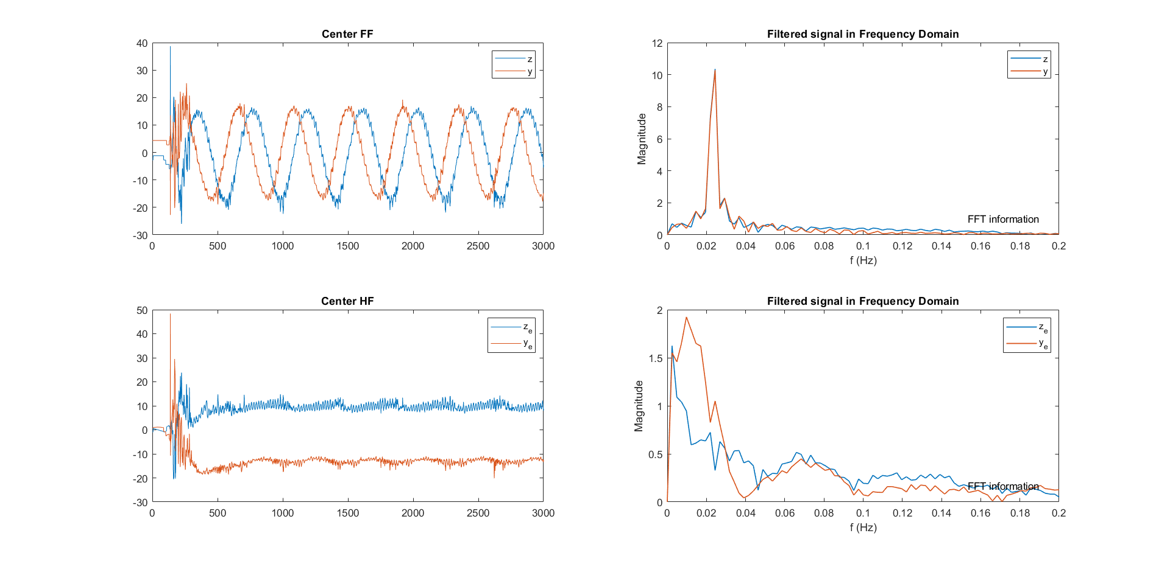
Control Design --- New Transform
Fixed Frame
Helix Frame

Slide 27
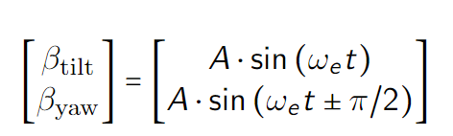
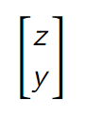
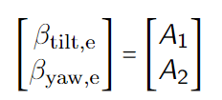
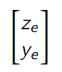
Control Design --- Relationship Map
Fixed Frame
FF beta
FF center
Helix Frame
HF beta
HF center
Notes:
There are four different combination that can be controlled
We explore the relation between input and output by first open-loop control the whole system

Slide 28
Control Design --- Lookback
How to integrate LiDAR and the helix approach for closed-loop wake mixing control for wind farms?
Which LiDAR configuration to use? √
What feature in the helix wake should be controlled, and how to obtain it using LiDAR? √
How to design the control loop to rectify the helix?
Potential for next step?
Notes:
So here, we answered the first question, what configuration of LiDAR to be used.

Slide 29
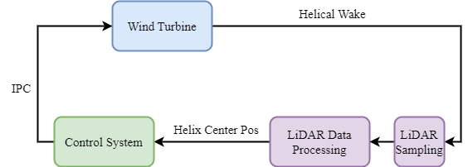
Control Design --- Overall Design
√
√
Notes:
Dead-time Delay

Slide 30
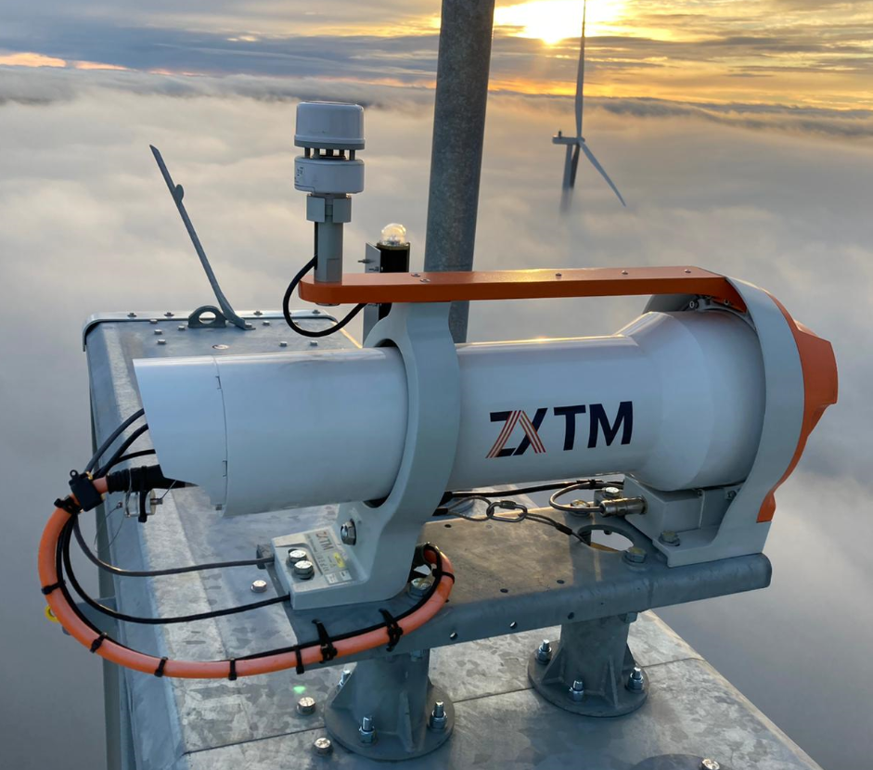
Control Design --- Analysis
LiDAR Data Processing Pipeline
Calculate Helix Center
Coordinate Transform
Filter
Control
Handle Delay

Slide 31
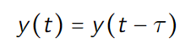
Control Design --- Deadtime Delay
Notes:
Dead-time Delay

Slide 32
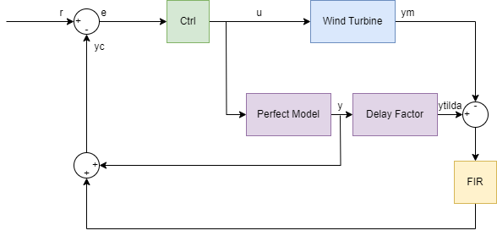
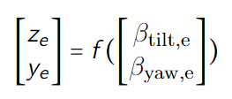
Control Design --- Smith Predictor

Slide 33
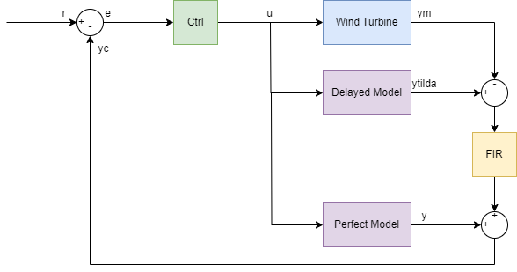
Control Design --- Smith Predictor
A perfect model
A delayed model
An adaptive filter
MIMO/SISO controller(s)
Close the loop in real-time

Slide 34
Chapter | dark mode
04
Current Progress
To prove that I’m not wasting time

Slide 35
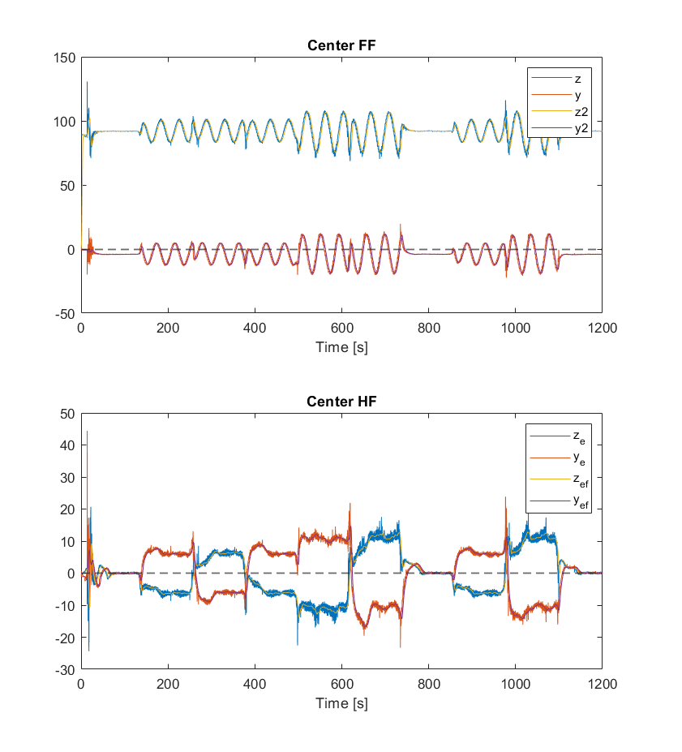
Current Progress --- LiDAR Data Processing
Start
Sim Over
Y
N
LiDAR sampling
Helix Center Calculation
LPF
Detrend
Coordinate Transfer
Over

Slide 36
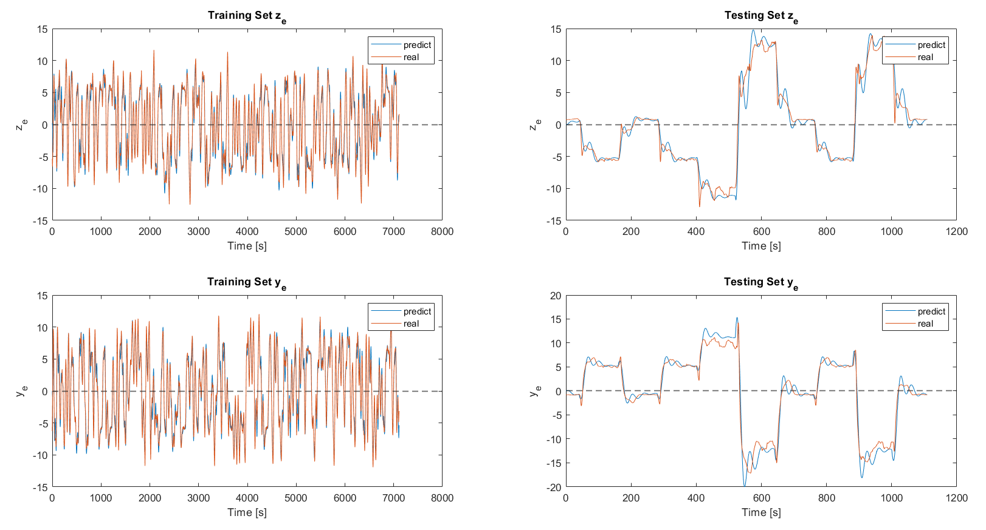
Current Progress --- Internal Model IDE

Slide 37
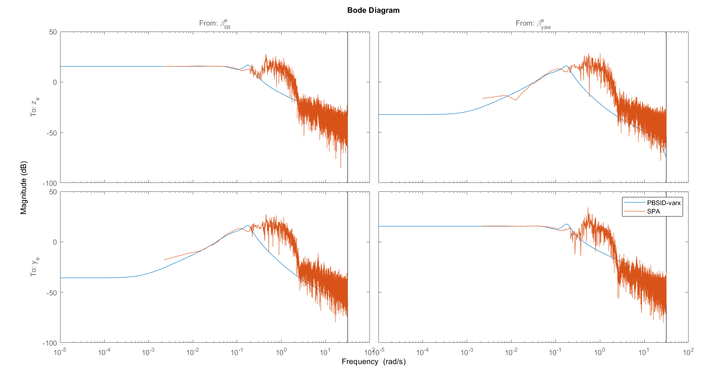
Current Progress --- Internal Model IDE
Notes:
Decouple

Slide 38
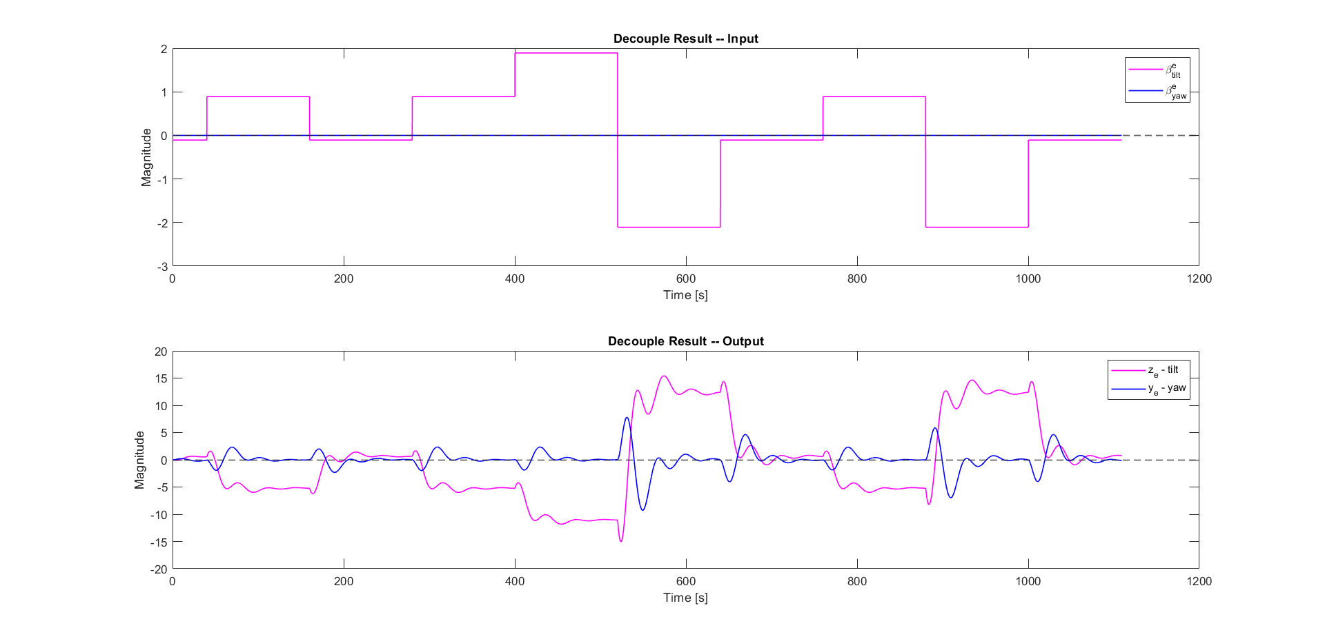
Current Progress --- Internal Model IDE
Notes:
Decouple

Slide 39
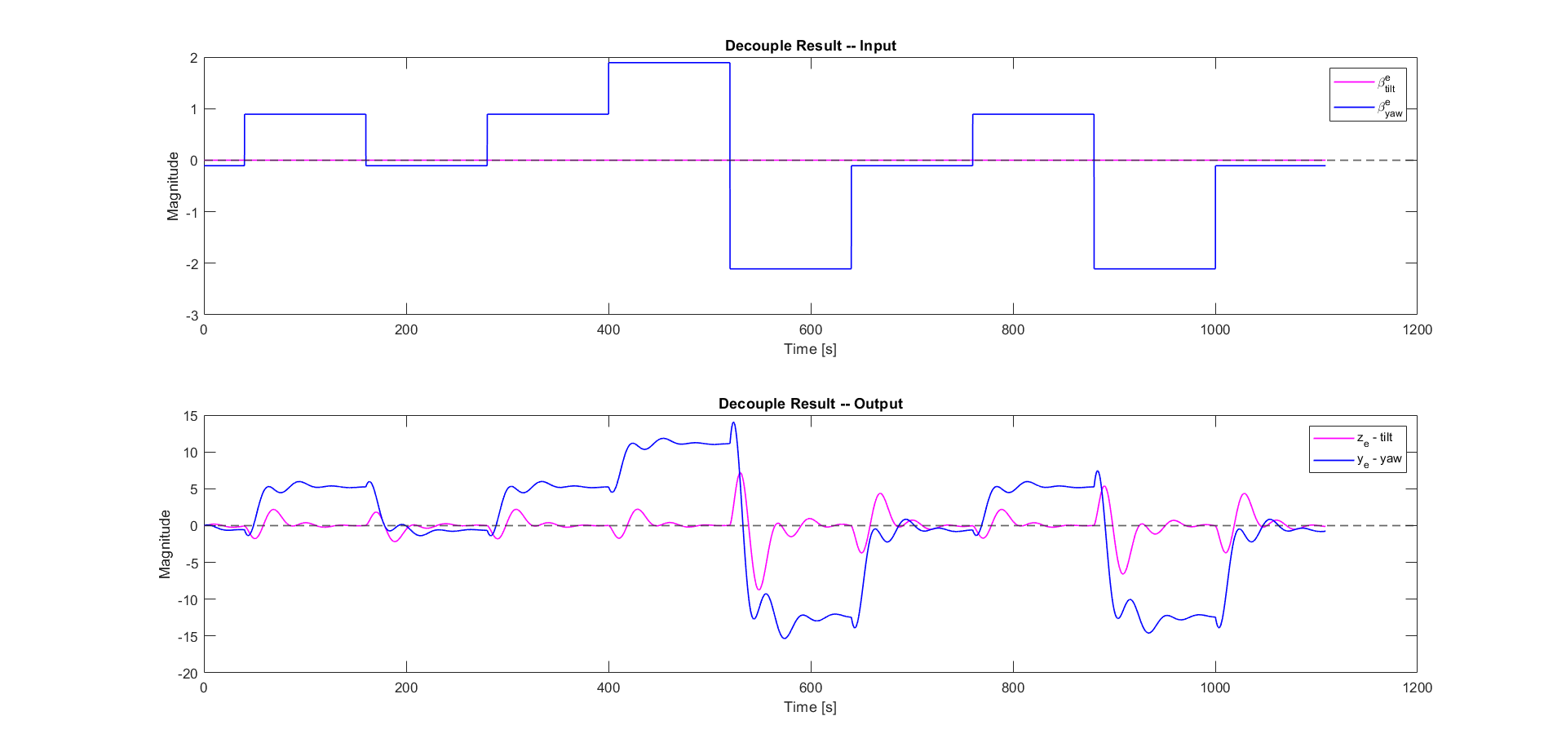
Current Progress --- Internal Model IDE
Notes:
Decouple

Slide 40

Current Progress --- Internal Model IDE
Result VAF
Analysis
Linearity!
Stability!
Steady-state decouple thanks to Azimuth Offset
 | Train Data | Test Data
Z | 96.5054 | 96.0452
Y | 96.5626 | 95.5183

Slide 41
Current Progress --- Internal Model IDE
Result VAF
Analysis
Linearity!
Stability!
Steady-state decouple thanks to Azimuth Offset
High frequency does not capture well
 | Train Data | Test Data
Z | 96.5054 | 96.0452
Y | 96.5626 | 95.5183

Slide 42
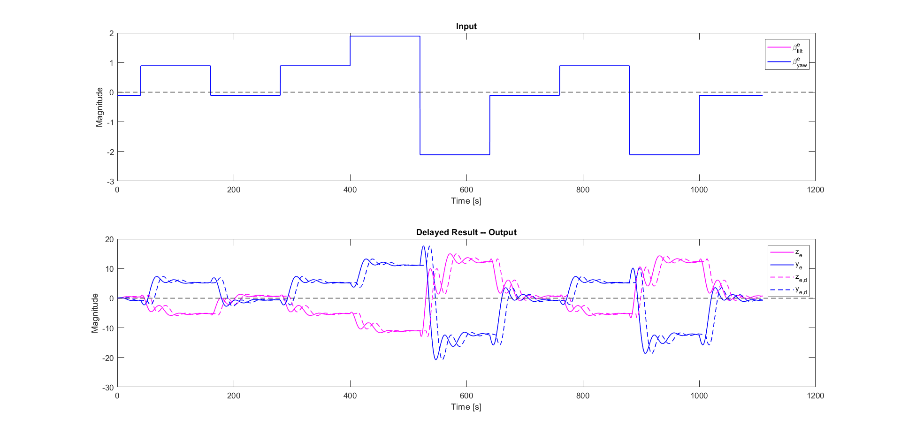
Current Progress --- Delayed Model
Notes:
Decouple

Slide 43
Chapter | dark mode
05
Future Work
Journey ahead

Slide 44
Challenge & Future Work
The uncaptured dynamic in certain frequency when designing SISO controllers
Close the loop
Gust and Turbulence

Slide 45
Thanks for listening :)

Slide 46
Chapter | dark mode
06
Q&A
Bring it in

Slide 47
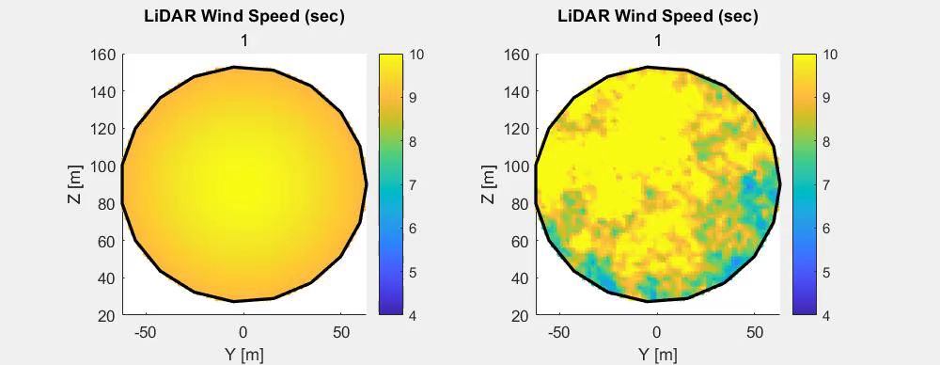
Why closed-loop control?
Notes:
With LiDAR, we are able to visualize the helix downwind, and based on some play arounds, we can answer the question of what to control

Slide 48
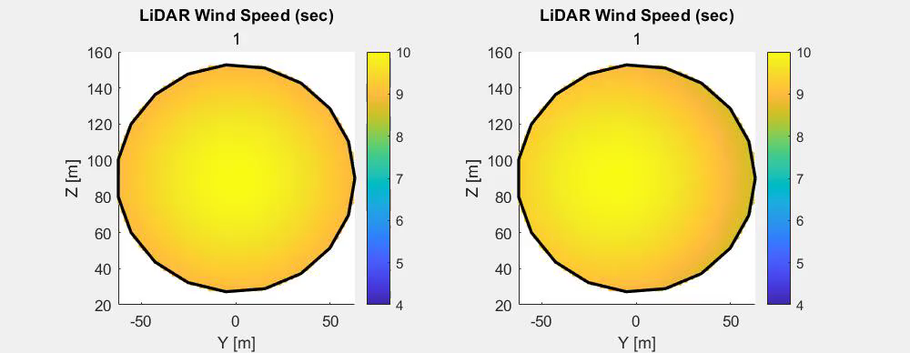
Why closed-loop control?
Notes:
With LiDAR, we are able to visualize the helix downwind, and based on some play arounds, we can answer the question of what to control

Slide 49
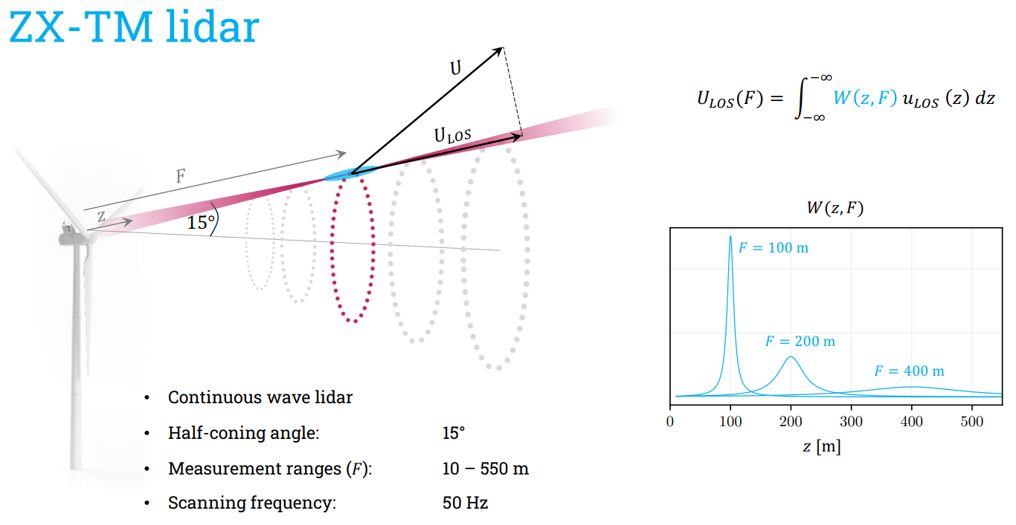

Slide 50
LiDAR Choosing
Trade off between practicality and quality --- Modified ZX-TM LiDAR
Continuous Wave LiDAR
Measure Distance: 10 – 720 m
Half-cone angle: -
Entire rotor disk

Slide 51
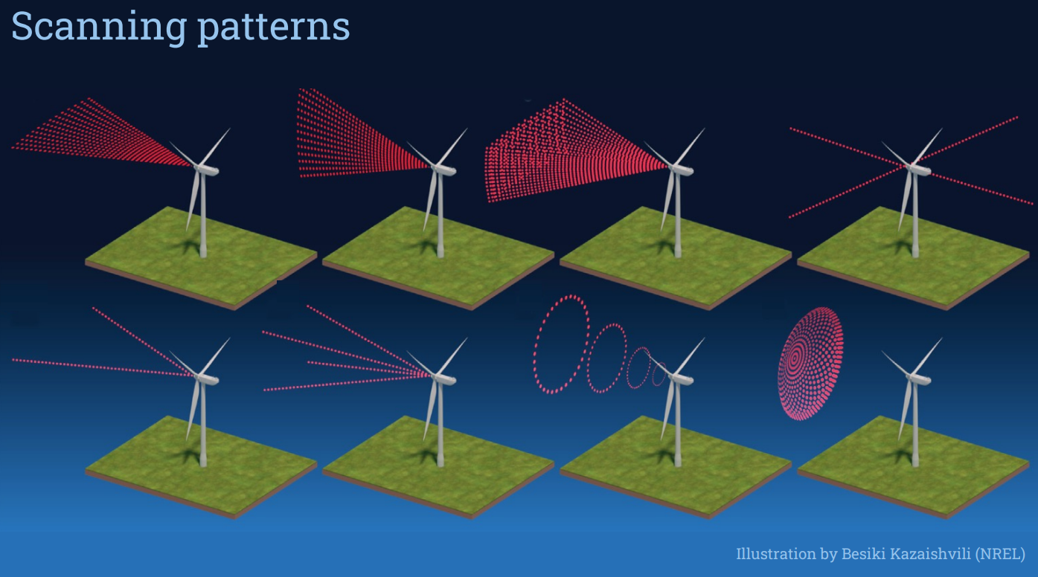

Slide 52
System IDE
Notes:
Dead-time Delay

Slide 53
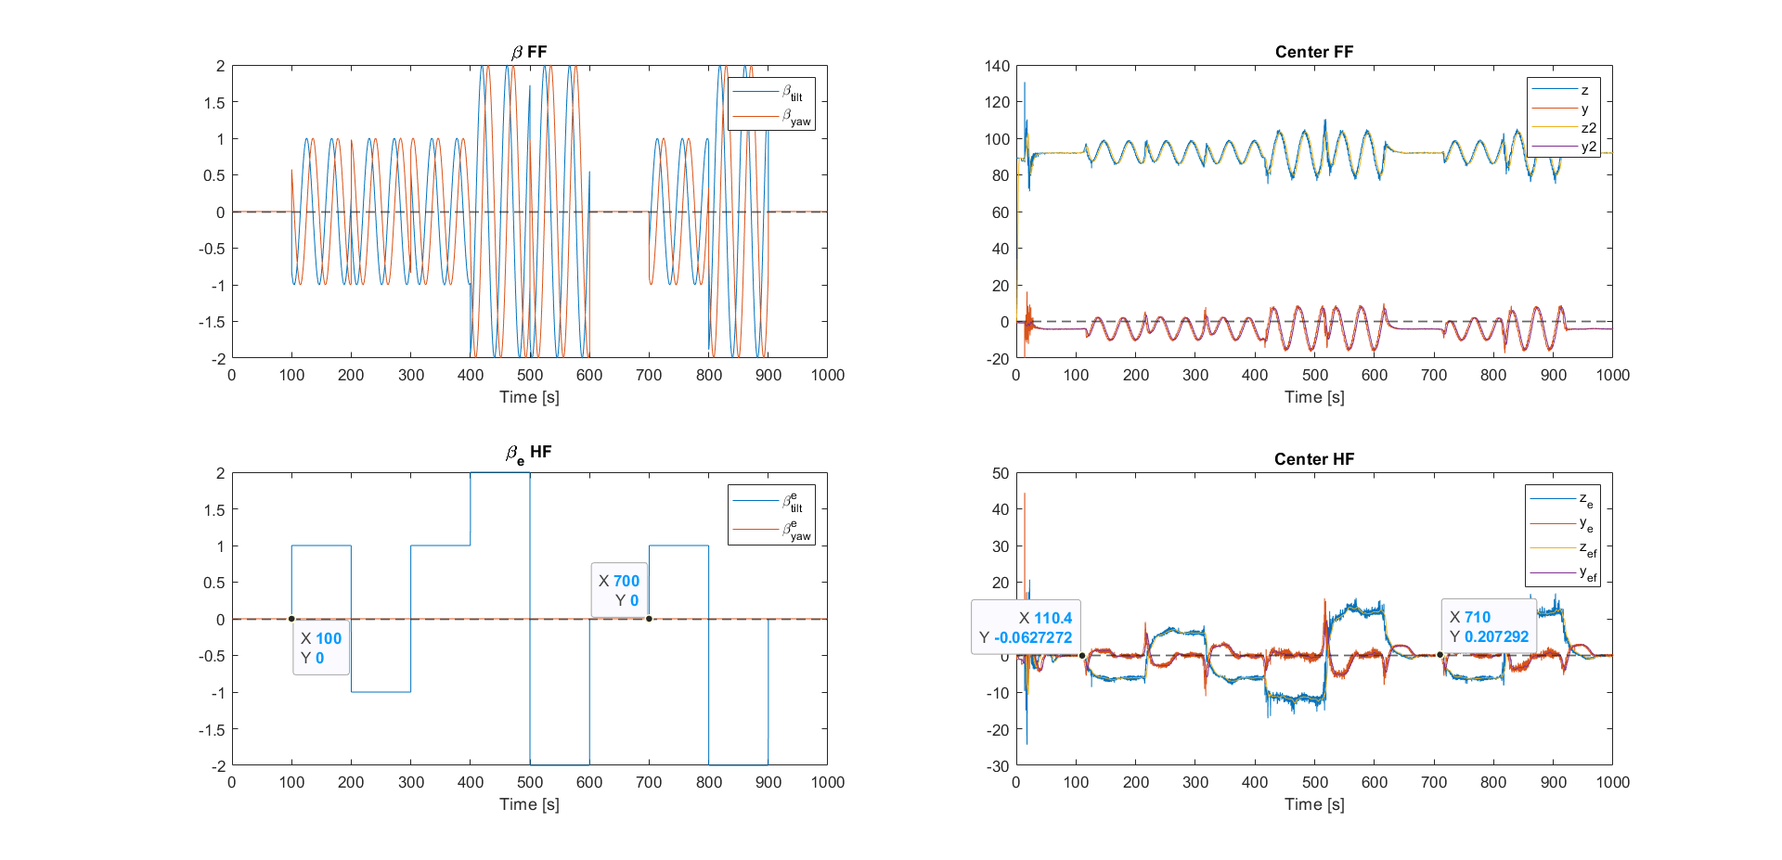
Deadtime Delay

Slide 54
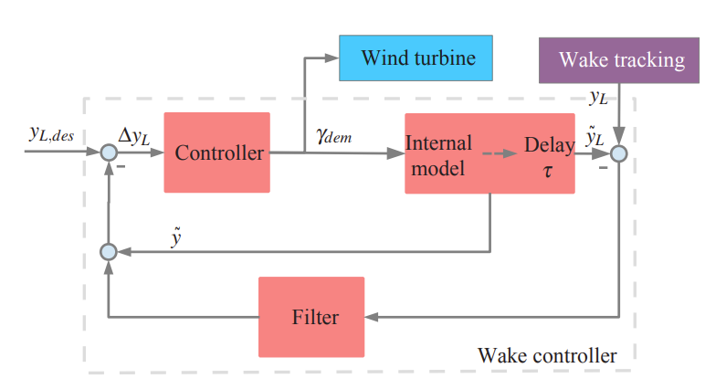


Smith Predictor
Notes:
Equations of internal model and delay.
The internal model predict the reaction of the wake to the demanded yaw angle. The first equation is the relationship of yaw, and then the second one is for the wake.

Slide 55
Comparison of outputs

Slide 56

Model Precision

Slide 57

Comparison of outputs
Notes:
Y is the dominate one compared to Yc

